Slide 1


Welcome!
HBC Community Breakfast

Slide 2
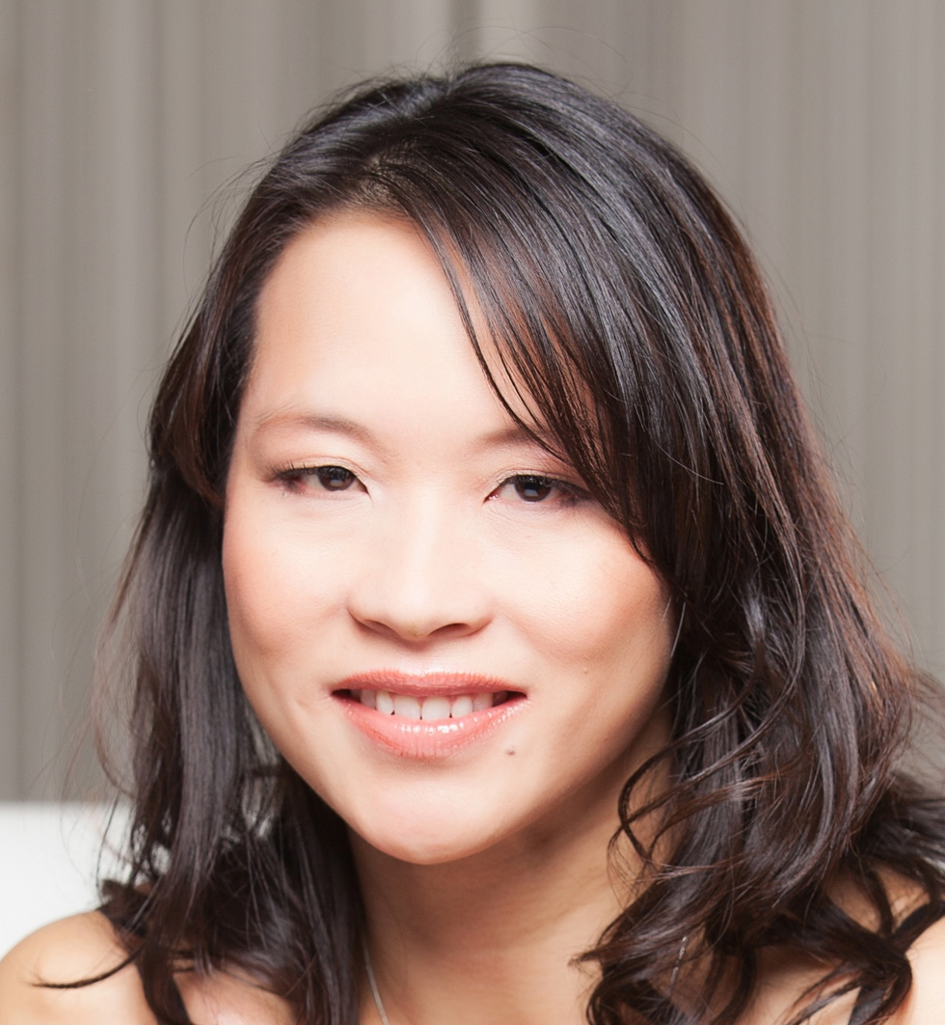
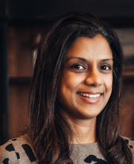
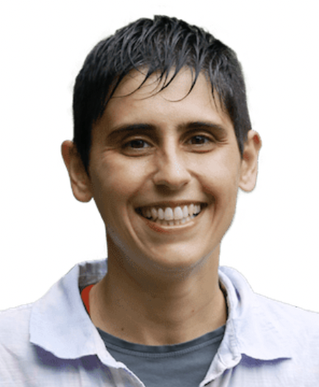
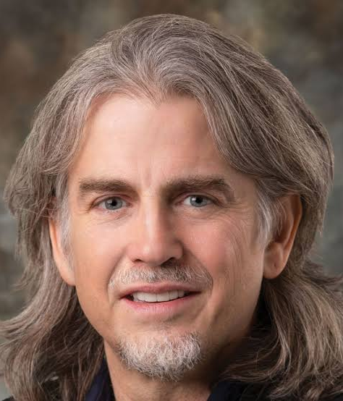
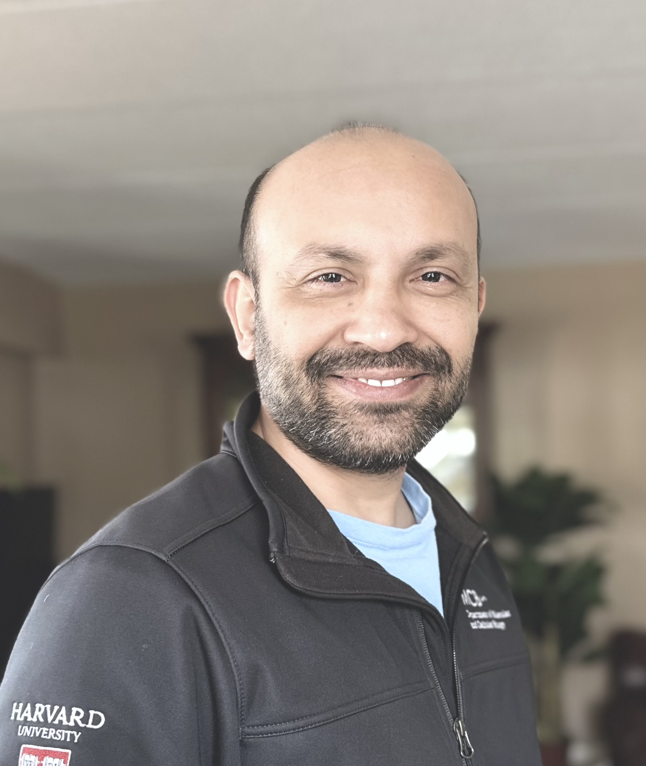
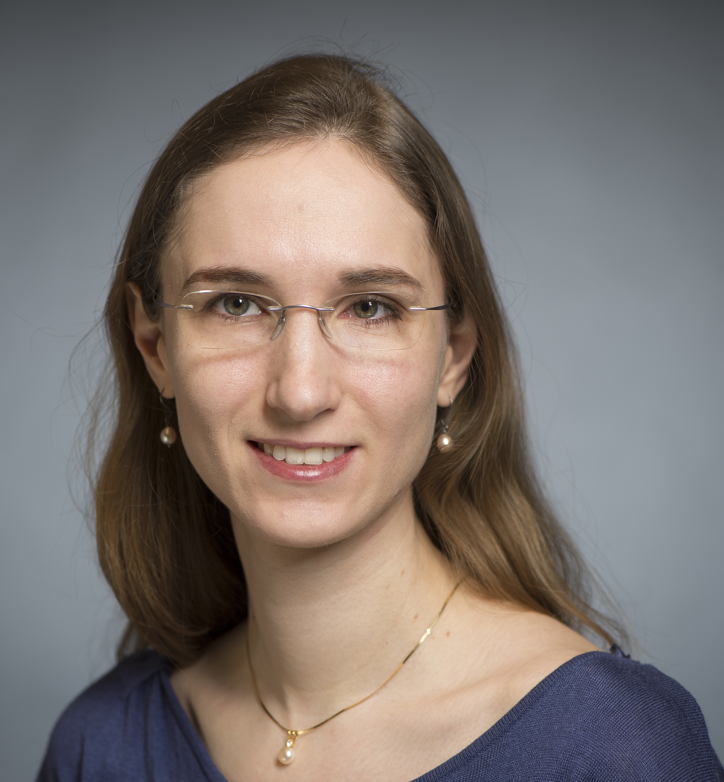
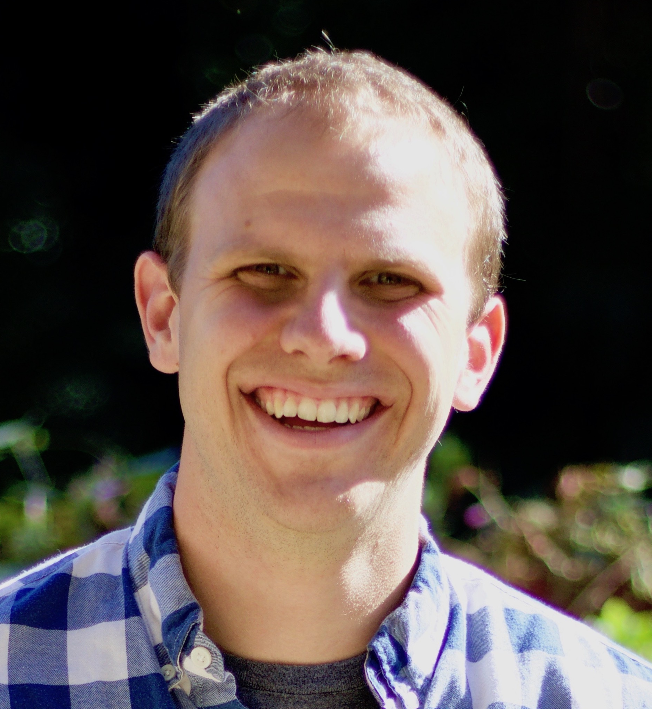
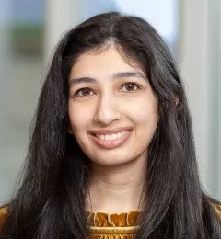
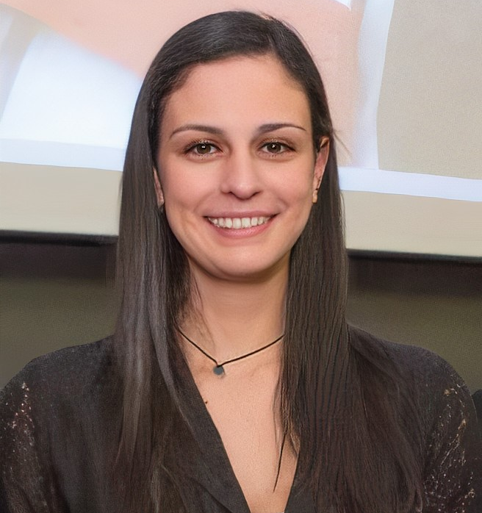
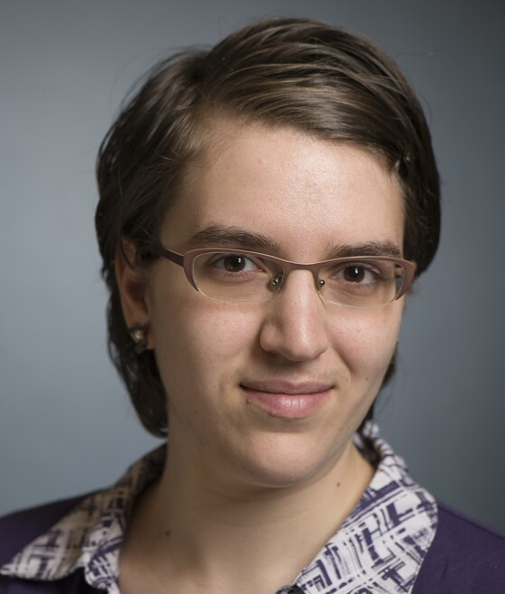
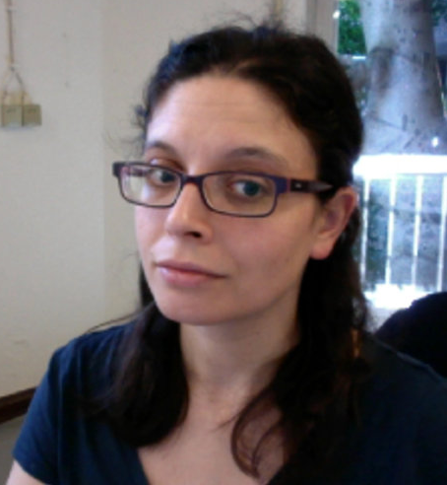
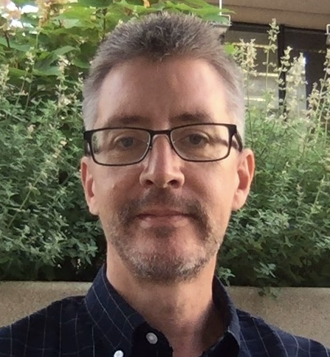
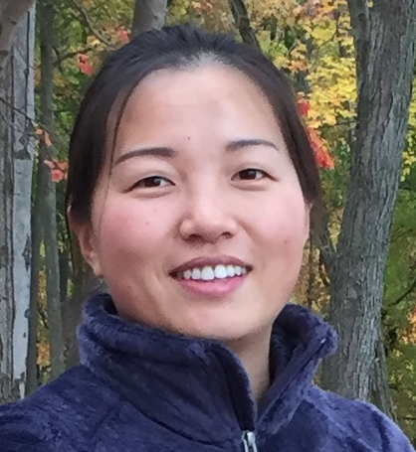
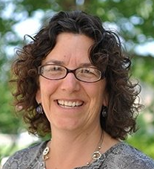
Shannan Ho Sui
Director
Meeta Mistry
Associate Director
Lorena Pantano
Director of Bioinformatics Platform
John Quackenbush
Faculty Advisor
Heather Wick
Noor Sohail
Upen Bhattarai
Heather Wick
Will Gammerdinger
Noor Sohail
Alex Bartlett
Elizabeth Partan
Emma Berdan
James Billingsley
Zhu Zhuo
Maria Simoneau

Slide 3



Training
Consulting
Basic Data Skills
Introduction to command-line (Unix) and high performance computing
Introduction to R
Advanced analysis of HTS data
Bulk RNA-seq
Single cell RNA-seq
Chromatin Biology
Variant calling
Transcriptomics: bulk, single cell, and small RNA-seq
Epigenetics: ChIP-seq, CUT&RUN, ATAC-seq, genome-wide methylation
DNA variation: WGS, resequencing, exome-seq and CNV studies
Spatial biology: CosmX, Visium MERFISH
Exp. design help & grant support

Slide 4
Welcome! HBC Community Breakfast
An opportunity to mingle and get to know each other in the community
Great conversations
Quarterly, 9am -10:30am – see you next in September!

Slide 5
Contact Us
HBC training team: hbctraining@hsph.harvard.edu
HBC consulting: bioinformatics@hsph.harvard.edu

